Slide 1
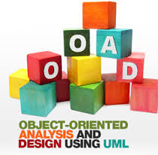
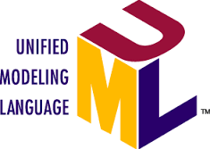
Course Name object oriented analysis and design
CSC 2210
(Undergraduate)
Software engineering (Undergraduate)
Chapter 2 INTRODUCTION TO UML
MOHAIMEN-BIN-NOOR
Assistant Professor, CS
mohaimen.niloy@aiub.edu

Slide 2
UML
Chapter 2: Introduction to UML
MOHAIMEN-BIN-NOOR
S.2
MM
Unified Modeling Language
UML is a standardized general-purpose modeling language in the field of software engineering. The standard is managed, and was created by, the Object Management Group (OMG) (http://www.omg.org/)
UML website: http://www.uml.org
Increase understanding/communication of product to customers and developers
Support for UML in many software packages today (e.g., UMLet, Rational Rose, ArgoUML, etc.)

Slide 3
Why Use UML
Chapter 2: Introduction to UML
MOHAIMEN-BIN-NOOR
S.3
MM
The UML is a language for Visualizing
The UML is a language for Specifying
Some things are best modeled textually; others graphically.
One developer can write a model in the UML, and another developer, or even another tool, can interpret that model unambiguously
Specifying means building models that are precise, unambiguous, and complete
In particular, the UML addresses the specification of all the important analysis, design, and implementation decisions that must be made in developing and deploying a software-intensive system.

Slide 4
Why Use UML
Chapter 2: Introduction to UML
MOHAIMEN-BIN-NOOR
S.4
MM
The UML is a language for Constructing
The UML is a language for Documenting
UML is not a visual programming language, but its models can be directly connected to a variety of programming languages
It is possible to map from a model in the UML to a programming language such as Java, C++, or VB, or even to tables in a RDBMS
The UML addresses the documentation of a system’s architecture and all of its details
The UML also provides a language for expressing requirements and for tests
Finally, the UML provides a language for modeling the activities of project planning and release management

Slide 5
Building blocks of uml
Chapter 2: Introduction to UML
MOHAIMEN-BIN-NOOR
S.5
MM
The vocabulary of the UML encompasses three kinds of building blocks:
Things - abstractions that are the primary concern in a model
Structural things - nouns/static parts of UML models
Behavioral things - verbs/dynamic parts of UML models
Grouping things - organizational parts of UML models
Annotation things - explanatory parts of UML models
Relationships - tie the things together
Diagrams - group collections of things

Slide 6
Structural things
Chapter 2: Introduction to UML
MOHAIMEN-BIN-NOOR
S.6
MMH
Structural things are the nouns of the UML model. These are the mostly static parts of a model, representing elements that are either conceptual or physical. There are Eight kinds of structural things.
1. A Class
A class can be defined as a template/blueprint that describes the behaviors/states that object of its type support.
Description of set of objects that share the same attributes, operations, relationships and semantics
Student
Name ID CGPA DOB
Study ( ) Play ( ) Eating ( )

Slide 7
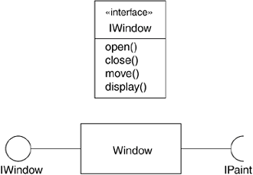
Structural things
Chapter 2: Introduction to UML
MOHAIMEN-BIN-NOOR
S.7
MMH
2. An interface
Is a collection of operations that specify a service of a class or component. An interface therefore describes the externally visible behavior of that element.
You cannot instantiate an interface. Therefore, interface does not contain any constructors.
An interface is not extended by a class; it is implemented by a class (unchanged in implementation).
An interface can extend multiple interfaces.

Slide 8

Structural things
Chapter 2: Introduction to UML
MOHAIMEN-BIN-NOOR
S.8
MMH
3. A collaboration: A collection of UML building blocks (classes, interfaces, relationships) that work together to provide some functionality within the system. (e.g., Interoperability, block chain technology to conned external system in providing one-stop e-services
4. A Use case is a description of set of sequence of actions that a system performs that yields an observable result of value to a particular actor.
Registration Course

Slide 9
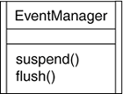
Structural things
Chapter 2: Introduction to UML
MOHAIMEN-BIN-NOOR
S.9
MMH
5. An active class
is a class whose objects (known active object) own one or more processes or threads and therefore can initiate control activity (modify variables, change program behavior, and so on).
Active object initiate and control the flow of activity, while passive object wait for another object to call them generally for store data and serve other classes.
Graphically, an active class is rendered as a class with double lines on the left and right

Slide 10

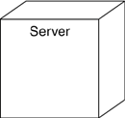
Structural things
Chapter 2: Introduction to UML
MOHAIMEN-BIN-NOOR
S.10
MMH
6. A Component is a packaging of classes, interfaces, and collaboration. Total program is divided into various parts or module.
7. An artifact is a physical and replaceable part of a system that contains physical information ("bits").
8. A Node: Computational resources that exists at run time, typically h/w resources e.g., memory, processor, etc.
Course.cpp

Slide 11
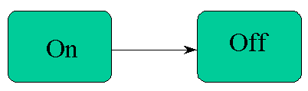

Behavioral things
Chapter 2: Introduction to UML
MOHAIMEN-BIN-NOOR
S.11
MMH
Behavioral things are the verbs of the UML model. These are the mostly dynamic parts of a model, representing behavior over time and space. There are three kinds of behavioral things.
A state machine is a behavior that specifies the sequences of states an object or an interaction goes through during its lifetime in response to events.
An Interaction is a set of messages exchanged among a set of objects to accomplish a specific purpose
An activity is a behavior that specifies the sequence of steps a computational process performs.

Slide 12
grouping things
Chapter 2: Introduction to UML
MOHAIMEN-BIN-NOOR
S.12
MM
The organizational parts of UML models. These are the boxes into which a model can be decomposed. There is one primary kind of grouping thing, namely, packages.
Organizing elements (structural/behavioral) into groups.
Purely conceptual. only exists at development time. And can be nested.
Variations of packages are: Frameworks, models, & subsystems.
University Administration
Course Manager
Student Admission
-Student
+Department

Slide 13

Annotational things
Chapter 2: Introduction to UML
MOHAIMEN-BIN-NOOR
S.13
MM
Annotational things are the explanatory parts of UML models.
These are the comments you may apply to describe, illuminate, and remark about any element in a model.
There is one primary kind of Annotational thing, called a note.

Slide 14
Relationships in uml
Chapter 2: Introduction to UML
MOHAIMEN-BIN-NOOR
S.14
MM
There are four kinds of relationships in the UML
Association
Generalization
Realization
Dependency
Association: is a structural relationship that describes a set of links. A link is a connection between objects.
Student
attends
University

Slide 15
Relationships in uml
Chapter 2: Introduction to UML
MOHAIMEN-BIN-NOOR
S.15
MM
Generalization: can be defined as a relationship which connects a specialized element with a generalized element. It basically describes inheritance (IS-A) relationship in the world of objects.
Student registration
parent
child
under-graduate
registration
graduate
registration

Slide 16


Relationships in uml
Chapter 2: Introduction to UML
MOHAIMEN-BIN-NOOR
S.16
MM
Realization: denotes the implementation (interface) of the functionality defined in one class by another class.
Dependency: is a relationship between two things in which change in one element also affects the other one.
class A3 implements B3
class A depends on class B

Slide 17
Diagrams in uml
Chapter 2: Introduction to UML
MOHAIMEN-BIN-NOOR
S.17
MM
A diagram is the graphical presentation of a set of elements, most often rendered as a connected graph of vertices (things) and arcs (relationships).
Class Diagram – Structural. Represents Static Design View or Static Process View.
Object Diagram – Structural. Represents Static Design View or Static Process View.
Component Diagram – Structural. Represents Static Implementation View.
Artifact Diagram – Structural. Represents Static Implementation View.
Use Case Diagram – Behavioral. Represents Static Use Case View.
Deployment Diagram – Structural. Represents Static Deployment View.

Slide 18
Diagrams in uml
Chapter 2: Introduction to UML
MOHAIMEN-BIN-NOOR
S.18
MM
A diagram is the graphical presentation of a set of elements, most often rendered as a connected graph of vertices (things) and arcs (relationships).
Interaction Diagram – Behavioral. Represents Dynamic View.
Sequence Diagram – Interaction Diagram emphasizing on time-ordering of messages.
Communication Diagram – Interaction Diagram emphasizing on structural organization of objects.
State Diagram – Behavioral. Represents Dynamic View of an object.
Activity Diagram – Behavioral. Represents Dynamic View.

Slide 19
Diagrams in uml
Chapter 2: Introduction to UML
MOHAIMEN-BIN-NOOR
S.19
MM
A diagram is the graphical presentation of a set of elements, most often rendered as a connected graph of vertices (things) and arcs (relationships).
Package Diagram – Represents Static View. Shows decomposition of model.
Timing Diagram – Interaction Diagram with specific time.
Interaction Overview Diagram – Hybrid of Interaction and Activity Diagram.
Composite structure diagram – Hybrid Diagram.

Slide 20
Architecture of OO Software System
Chapter 2: Introduction to UML
M. Mahmudul Hasan
S.20
MM
To understand the architecture of object oriented software system, one needs several complementary and interlocking views.
Each of these views may have structural, as well as behavioural, aspects. Together these views represent the blueprints of Object Oriented Software System.

Slide 21
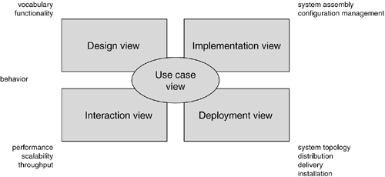
System architecture modeling
Chapter 2: Introduction to UML
M. Mahmudul Hasan
S.21
MMH

Slide 22
Architecture of OO Software System
Chapter 2: Introduction to UML
M. Mahmudul Hasan
S.22
MM
A use case view – exposes the behaviour of the system.
A design view – captures the vocabulary and functionality of the system.
A process view – models the distribution of the system’s processes and threads and addresses the performance and scalability.
An implementation view – addresses the physical realization of the system, system assembly and configuration management.
A deployment view – focuses on system topology, distribution, delivery and installation.

Slide 23
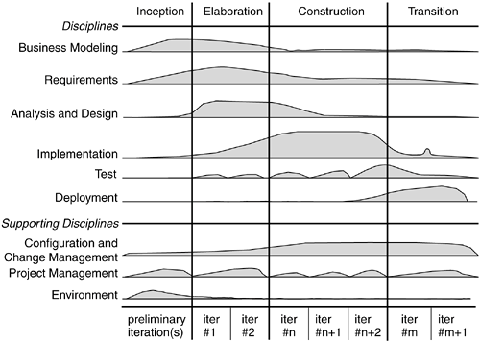
SDLC – Rational Unified Model (RUP)
Chapter 2: Introduction to UML
M. Mahmudul Hasan
S.23
MM

Slide 24
SDLC – Rational Unified Model (RUP)
Chapter 2: Introduction to UML
M. Mahmudul Hasan
S.24
MM
Inception is the first phase of the process, when the seed idea for the development is brought up to the point of being at least internally sufficiently well-founded to warrant entering into the elaboration phase.
Elaboration is the second phase of the process, when the product requirements and architecture are defined. In this phase, the requirements are articulated, prioritized, and baselined. A system's requirements may range from general vision statements to precise evaluation criteria, each specifying particular functional or nonfunctional behavior and each providing a basis for testing.
Construction is the third phase of the process, when the software is brought from an executable architectural baseline to being ready to be transitioned to the user community. Here also, the system's requirements and especially its evaluation criteria are constantly reexamined against the business needs of the project, and resources are allocated as appropriate to actively attack risks to the project.

Slide 25
SDLC – Rational Unified Process (RUP)
Chapter 2: Introduction to UML
M. Mahmudul Hasan
S.25
MM
Transition is the fourth phase of the process, when the software is delivered to the user community. Rarely does the software development process end here, for even during this phase, the system is continuously improved, bugs are eliminated, and features that didn't make an earlier release are added.
Iteration is a distinct set of work tasks, with a baselined plan and evaluation criteria that results in an executable system that can be run, tested, and evaluated.

Slide 26
references
Chapter 2: Introduction to UML
M. Mahmudul Hasan
S.26
MM
Booch, G., Rumbaugh, J. & Jacobson, I. (2005). The unified modeling language user guide. Pearson Education India.

